Slide 1
Graph coloring Problem
and its Applications
Presented by :
Raunak Tiwari - 180123038
Satyadev Badireddi - 180123041

Slide 2
Overview
Introduction to Graph Coloring
Algorithms for graph Coloring
Applications of graph coloring

Slide 3
Introduction to Graph Coloring
The Graph Coloring Problem is defined as : Given an undirected Graph G(V, E) ,each vertex is to be assigned a color(a label) in such a way that the colors on any pair of adjacent vertices are different.
Chromatic Number : The smallest number of colors needed to color the graph G is called its chromatic number denoted as χ(G).
K-colorable : A graph is said to be k-colorable if it can be properly colored using k colors.
Vertex Covering Problem is one of the classic NP-complete problems. It is NP- Complete to determine if the given graph is k- colorable for all values of k except for 0,1 and 2. For k > 3, k colorings exist on planar graphs by the four color theorem.
Brooks theorem states that in connected, simple graphs which are not complete or odd cycles, the chromatic number is less than the maximum vertex degree of the graph.

Slide 4
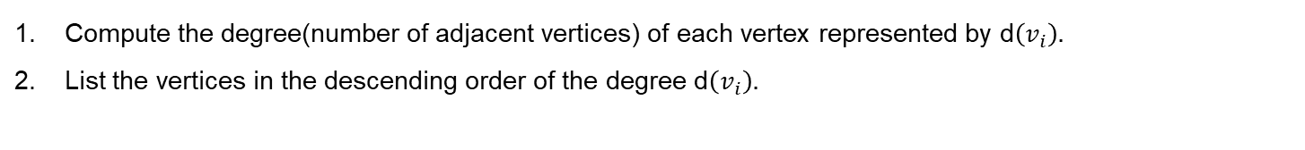
Algorithms for graph Coloring
Unfortunately, there is no efficient algorithm available for coloring a graph with minimum number of colors as the problem is a known NP complete problem. There are approximate algorithms to solve the problem though. We shall refer to the research paper named “A Performance comparison of graph coloring algorithms” mentioned in reference no. 2. In this paper, we compared different graph coloring algorithms such as First Fit Algorithm, Welsh – Powell Algorithm, Largest Degree Ordering, Recursive Largest First Algorithm, Degrees of Saturation Algorithm. Of all these algorithms , Welsh Powell algorithm finds out the best solution in the shortest time.
Welsh - Powell Algorithm
It is a heuristic algorithm that uses an iterative greedy approach to color the graph.
Pseudo Code:
We have a graph G(V,E) with n vertices from $v_{1},v_{2}, to v_{n}$. Colors are ordered in a list C.
Compute the degree(number of adjacent vertices) of each vertex represented by d$\left(v_{i}\right).$
List the vertices in the descending order of the degree d$\left(v_{i}\right).$

Slide 5
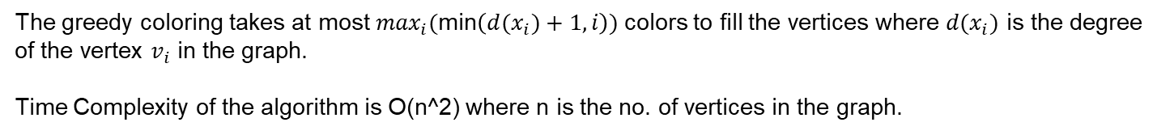
Algorithms for graph Coloring
The non colored vertex with the highest degree is colored with the first color in C.
The list is traversed and the vertices which are not adjacent to the colored vertex above are allocated the same color and all these non adjacent vertices are deleted from the list.
Steps 3 and 4 are iterated until all the vertices have been colored.
Analysis:
The greedy coloring takes at most $\max_{i}($min$\left({d(x}_{i})+1,i\right))$ colors to fill the vertices where ${d(x}_{i})$ is the degree of the vertex $v_{i}$ in the graph.
Time Complexity of the algorithm is O(n^2) where n is the no. of vertices in the graph.

Slide 6
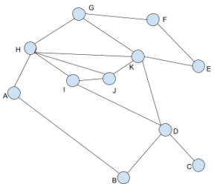
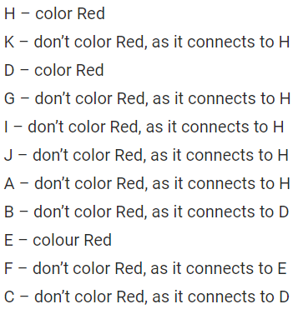
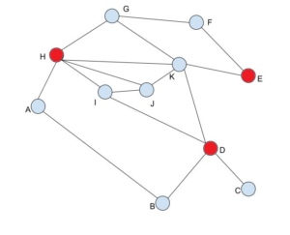
Algorithms for graph Coloring
Example:
First, order the list in descending order of degrees.
So, the new order will be : H, K, D, G, I, J, A, B, E, F, C.

Slide 7
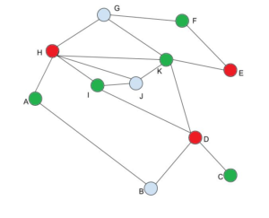
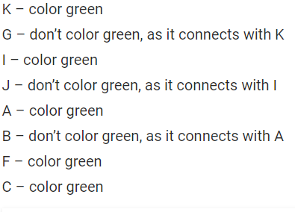
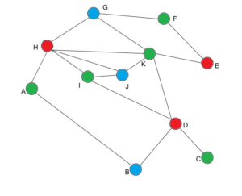

Algorithms for graph Coloring

Slide 8
Applications of graph coloring
1. Exam timetabling problem
Problem Statement :
We want to make an exam schedule for a university, we have list of different subjects and students enrolled in every subject. Many subjects would have common students (of same batch, some backlog students, etc).
How do we schedule the exam so that no two exams with a common student are scheduled at same time? How many minimum time slots are needed to schedule all exams?
This problem can be represented as a graph where every vertex is a subject and an edge between two vertices mean there is a common student. So this is a graph coloring problem where minimum number of time slots is equal to the chromatic number of the graph.
Relationship to a Graph :

Slide 9
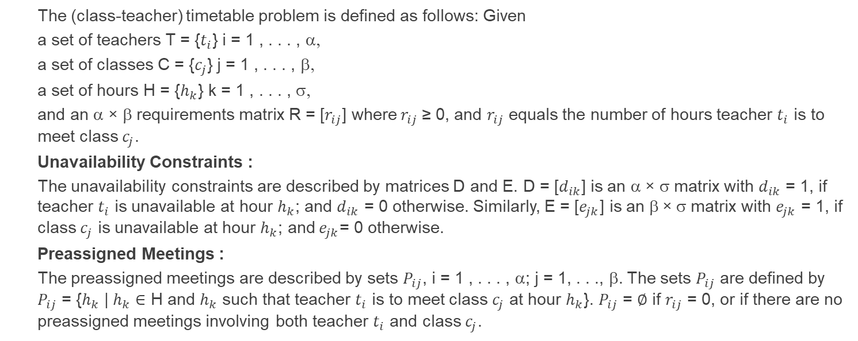
Applications of graph coloring
2. Existence of solution to class-teacher timetabling problem (CTTP)
(Studied with the help of research paper mentioned in reference no. 3)
Problem Statement :
The (class-teacher) timetable problem is defined as follows: Given
a set of teachers T = {$t_{i}$} i = 1 , . . . , α,
a set of classes C = {$c_{j}$} j = 1 , . . . , β,
a set of hours H = {$h_{k}$} k = 1 , . . . , σ,
and an α × β requirements matrix R = [$r_{ij}$] where$r_{ij}$≥ 0, and $r_{ij}$ equals the number of hours teacher $t_{i}$ is to meet class $c_{j}$.
Unavailability Constraints :
The unavailability constraints are described by matrices D and E. D = [$d_{ik}$] is an α × σ matrix with $d_{ik}$ = 1, if teacher $t_{i}$ is unavailable at hour $h_{k}$; and $d_{ik}$ = 0 otherwise. Similarly, E = [$e_{jk}$] is an β × σ matrix with $e_{jk}$ = 1, if class $c_{j}$ is unavailable at hour $h_{k}$; and${ e}_{jk}$= 0 otherwise.
Preassigned Meetings :
The preassigned meetings are described by sets $P_{ij}$, i = 1 , . . . , α; j = 1, . . ., β. The sets $P_{ij}$ are defined by $P_{ij}$ = {$h_{k}$ | $h_{k}$ $∈$ H and $h_{k}$ such that teacher $t_{i}$ is to meet class $c_{j}$ at hour $h_{k}$}. $P_{ij}$ = $∅$ if $r_{ij}$ = 0, or if there are no preassigned meetings involving both teacher $t_{i}$ and class $c_{j}$.

Slide 10
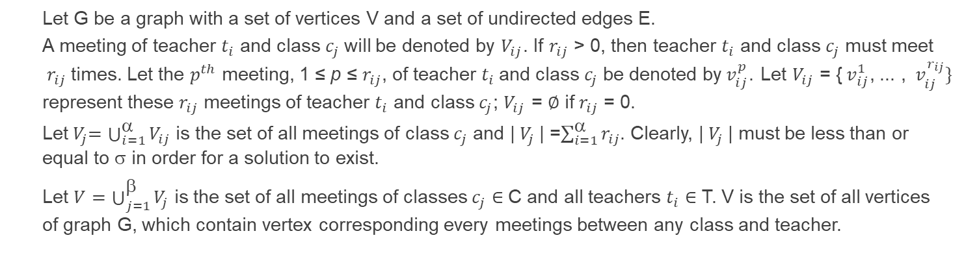
Applications of graph coloring
Is it possible to form a timetable without violating any constraints?
Relationship to a Graph :
Now we will try to transform CTTP into a graph coloring problem such that each vertex represents a lesson between a teacher and a class, an edge joining two vertices indicates that the respective associated lessons cannot be scheduled at the same hour and each color represents one hour of the corresponding timetable. So, solution should exist if and only if the graph is σ -colorable.
Let G be a graph with a set of vertices V and a set of undirected edges E.
A meeting of teacher $t_{i}$ and class $c_{j}$will be denoted by $V_{ij}$. If $r_{ij}$ > 0, then teacher $t_{i}$ and class $c_{j}$ must meet$r_{ij}$ times. Let the $p^{th}$ meeting, 1 ≤ p ≤ $r_{ij}$, of teacher $t_{i}$and class $c_{j}$be denoted by${ v}_{ij}^{p}$. Let $V_{ij}$ = {${ v}_{ij}^{1}$, ... , ${ v}_{ij}^{r_{ij}}\}$ represent these $r_{ij}$ meetings of teacher $t_{i}$ and class $c_{j}$; $V_{ij}$ = $∅$ if $r_{ij}$ = 0.
Let${ V}_{j}=\bigcup_{i=1}^{\text{a}}{V_{ij}}$ is the set of all meetings of class $c_{j}$ and | $V_{j}$| =$\sum_{i=1}^{\text{a}}{r_{ij}}$. Clearly, | $V_{j}$| must be less than or equal to σ in order for a solution to exist.
Let $V=\bigcup_{j=1}^{\text{b}}{V_{j}}$ is the set of all meetings of classes $c_{j}∈$ C and all teachers $t_{i}$ $∈$ T. V is the set of all vertices of graph G, which contain vertex corresponding every meetings between any class and teacher.

Slide 11
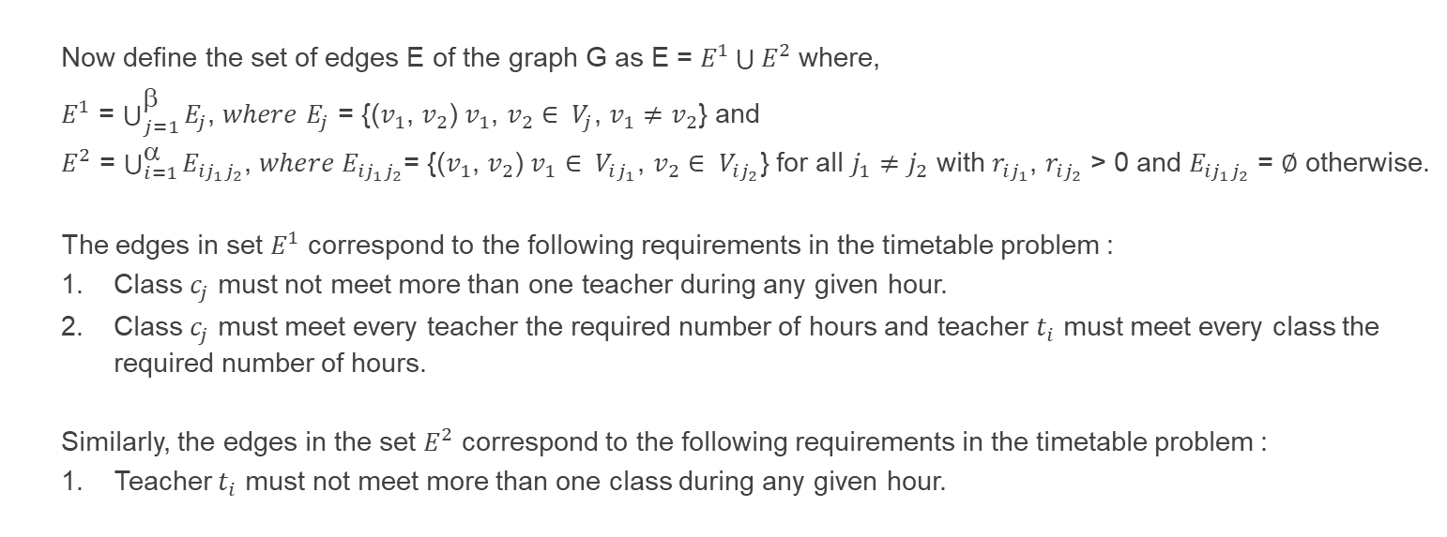
Applications of graph coloring
Now define the set of edges E of the graph G as E = $E^{1}\bigcup{E^{2}}$ where,
$E^{1}$ = $\bigcup_{j=1}^{\text{b}}{E_{j}}$, $where$ $E_{j}$ = {($v_{1}$, $v_{2}$) $v_{1}$, $v_{2}$ $∈$ ${ V}_{j}$, $v_{1}$ $≠$ $v_{2}$} and
$E^{2}$ = $\bigcup_{i=1}^{\text{a}}{E_{{ij}_{1}j_{2}}}$, $where E_{{ij}_{1}j_{2}}$= {($v_{1}$, $v_{2}$) $v_{1}∈$ ${ V}_{ij_{1}}$, $v_{2}∈$ ${ V}_{ij_{2}}$} for all $j_{1}≠j_{2}$ with $r_{ij_{1}}$, $r_{ij_{2}}$ > 0 and $E_{{ij}_{1}j_{2}}$= $∅$ otherwise.
The edges in set $E^{1}$ correspond to the following requirements in the timetable problem :
Class $c_{j}$ must not meet more than one teacher during any given hour.
Class $c_{j}$ must meet every teacher the required number of hours and teacher $t_{i}$ must meet every class the required number of hours.
Similarly, the edges in the set $E^{2}$ correspond to the following requirements in the timetable problem :
Teacher $t_{i}$ must not meet more than one class during any given hour.

Slide 12
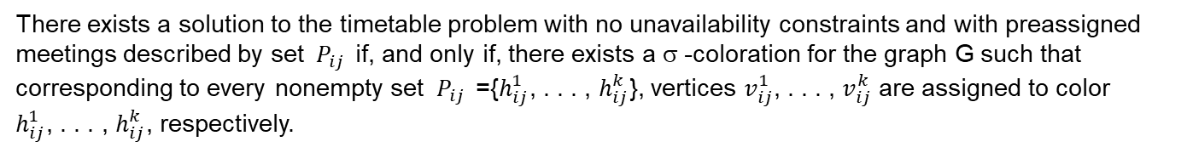
Applications of graph coloring
Solution to the timetable problem having no unavailability constraints nor preassigned meetings :
There exists a solution to the timetable problem having no unavailability constraints nor preassigned meetings if, and only if, there exists a σ -coloration for the graph G.
Solution to the timetable problem with unavailability constraints and no preassigned meetings :
There exists a solution to the timetable problem with unavailability constraints described by matrix D and no preassigned meetings if, and only if, there exists a σ -coloration for the graph G such that for every ${ d}_{ik }=1$, no vertex in the set ${ V}_{ij }$, j = 1 , . . . , β is assigned to color $h_{k}$.
There exists a solution to the timetable problem with unavailability constraints described by matrix E and no preassigned meetings if, and only if, there exists a σ -coloration for the graph G such that for every ${ e}_{jk }=1$, no vertex in the set ${ V}_{ij }$, i = 1 , . . . , α is assigned to color $h_{k}$.
Solution to the timetable problem with no unavailability constraints and with preassigned meetings :
There exists a solution to the timetable problem with no unavailability constraints and with preassigned meetings described by set ${ P}_{ij }$if, and only if, there exists a σ -coloration for the graph G such that corresponding to every nonempty set ${ P}_{ij }$ ={$h_{ij}^{1}$, . . . , $h_{ij}^{k}$}, vertices $v_{ij}^{1}$, . . . , $v_{ij}^{k}$ are assigned to color $h_{ij}^{1}$, . . . , $h_{ij}^{k}$, respectively.

Slide 13
References
Link : https://en.wikipedia.org/wiki/Graph_coloring
Link : https://www.researchgate.net/publication/309585874_A_Performance_Comparison_of_Graph_Coloring_Algorithms
Link : https://dl.acm.org/doi/pdf/10.1145/361082.361092

Slide 14
Thank You

